Slide 1
Introduction to DASH
SmartNIC Summit
Jun 13, 2023
Kristina Moore - Principal PM, Azure Core, MSFT

Slide 2
Introducing – SONiC (The foundation for DASH)
SONiC (Software Open Source for Networking in the Cloud)
Created by Microsoft and its partners; later migrated to Linux Foundation
Removes the requirement to run the switch suppliers NOS (KEY)
Containerized solution offering consistent operations, maintenance, monitoring, telemetry streaming, and security
Running on 100s of 1000s of SONiC switches powering Azure’s Cloud
Bringing 100+ Network Operating Systems -> 1 NOS
Notes:
Makes operating our SDN systems much easier.
Supported on 100’s of different physical switches, and on switch ASICS if they are running in the cloud today.

Slide 3
Azure’s Cloud is composed on SONiC enabled Switching
(Constructed from “any” Switching Hardware Platforms)
Tier 3 - Regional Hub
1.7–6.8+ Peta bps
T3-1
T3-2
T3-3
T3-4
Tier 2 – Spine
1.7–6.8+ Peta bps
…
…
…
T2-1-1
T2-1-2
T2-1-8
T2-4-1
T2-4-2
T2-4-4
SONiC for Chassis Coming Soon
Tier 1 – MoR
25.6-102.4+ Tera bps
…
…
…
T1-1
T1-2
T1-7
T1-8
T1-1
T1-2
T1-7
T1-8
T1-1
T1-2
T1-7
T1-8
SONIC
NOS
SONIC
NOS
SONIC
NOS
SONIC
NOS
SONIC
NOS
SONIC
NOS
…
…
…
Tier 0/ToR – Rack
3.2-6.4+ Tera bps
T0-1
T0-2
T0-20
T0-1
T0-2
T0-20
T0-1
T0-2
T0-20
SONIC
SONIC
SONIC
SONIC
SONIC
SONIC
SONIC
SONIC
SONIC
Servers
Servers
Servers
Notes:
Operates across all of our switches – fixed form and chassis
Petabits of data

Slide 4
Introducing – Microsoft Inspired DASH
DASH – Disaggregated APIs for SONiC Hosts
Created by Microsoft and its partners by way of SONiC extensions; later migrated to Linux Foundation
To achieve 10-100x perf in cloud connection management scale than offered in today’s Cloud & Enterprise
By maximizing innovation across Switch and DPU/IPU in a complementary manner where 1+1 is even greater than 3
Notes:
Sitting in GitHub for ~1.5+ year
Every DPU and Switch vendor in the forum
DPUs are running SONiC
To combine switching and DPU technologies together; host, SmartSwitch, or Appliance
DPUs are going to be 1.6T in the future, we would not want all 1.6T on a host. We would want this in a SmartSwitch, ToR, or Appliance above it to combine the resources

Slide 5
SONiC DASH Components
(100x Cloud Networking and Connection Management Performance over Software Only)
Nearly every IPU/DPU vendor
IPU/DPU/Smart NIC
Smart Switch
FPGA/NIC/ASIC
Standard APIs
P4 based behavioral models (KEY)
Test Suites
Programmable Intelligent HW
Open-Source Community
DASH
Cloud & Enterprise providers
Hardware OEM/ODM
Application providers (5G, Edge ..)
Ecosystem
SONiC Based
Built on an Established eco-system
Mature open-source community
Highly disaggregated components
Extensibility
Security
Hitless Upgradability and more

Slide 6


Introducing Appliance/Switch - Powered by DASH
(10s of Millions of Connections/Sec!)
SDN policies evaluation
TOR
Hyper-V Switch
VFP
Offload SDN policies evaluation to disaggregated switch/appliance
FPGA/ASIC
SDN Appliance/ Smart Switch
Lower power, lower latency
Hyper-V Switch
VFP
Higher throughput and IO
DASH
DPUs
FPGA/ASIC
TOR
Notes:
This is the problem we are trying to solve. Disaggregate the DPUs from the host.
Pulled them into an appliance or switch (pooling / disaggregating).
We tunnel VXLan from the VM to the Appliance/Switch for policy management.
10’s of M of CPS to keep up with demands of the VMs

Slide 7

DASH (Disaggregates Cloud Networking from the Host)
Tier 3 - Regional Hub
T3-1
T3-2
T3-3
T3-4
…
…
…
Tier 2 - Spine
T2-1-1
T2-1-2
T2-1-8
T2-4-1
T2-4-2
T2-4-4
Smart Switch
…
…
…
T1-1
T1-2
T1-7
T1-8
T1-1
T1-2
T1-7
T1-8
Tier 1 – MoR
T1-1
T1-2
T1-7
T1-8
SONIC
NOS
SONIC
NOS
SONIC
NOS
SONIC
NOS
Smart Switch
SONIC
NOS
SONIC
NOS
…
…
…
Tier 0/ToR - Rack
T0-1
T0-2
T0-20
T0-1
T0-2
T0-20
T0-1
T0-2
T0-20
SONIC
SONIC
SONIC
SONIC
SONIC
SONIC
SONIC
SONIC
SONIC
Smart ToR
Servers
Servers
Servers
Server or Appliance
Notes:
Can live on any tier
Representative diagram
https://github.com/sonic-net/DASH/blob/main/documentation/general/dash-high-level-design.md#example-of-network-representation

Slide 8
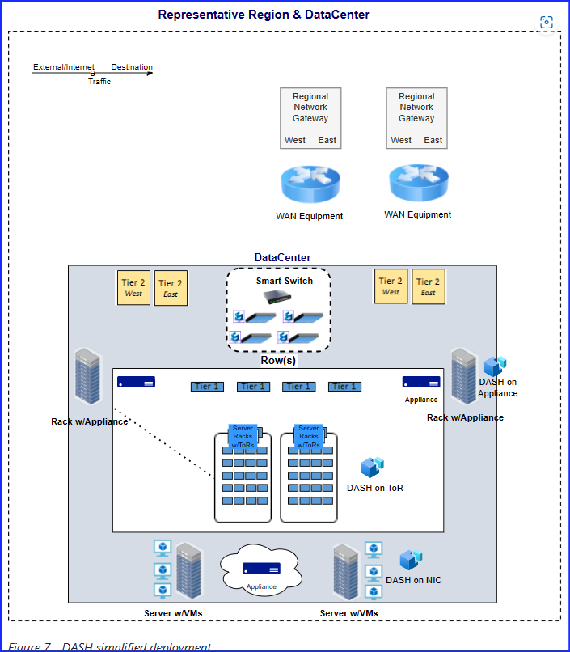
DASH (Disaggregates Cloud Networking from the Host)
Notes:
Can live on any tier
Representative diagram
https://github.com/sonic-net/DASH/blob/main/documentation/general/dash-high-level-design.md#example-of-network-representation

Slide 9
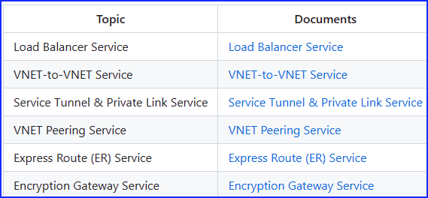
High Level Roadmap
Working on
SDN
Cloud Infra
Offload CPU
Next
Load Balancer +Encryption
5G/Edge
Future
Storage/AI
Enterprise
Offload GPU
https://github.com/sonic-net/DASH/tree/main/documentation#service-specifications-and-requirements
Notes:
Every DPU already supports encryption (Open SSL for example)
We don’t have to invent high-speed encryption
Key Exchange, TLS, SSL, Vnet Encryption, etc…
CPU clusters and AI clusters w/BE Infiniband with FrontEnd facing cloud infrastructure with SmartSwitches
SDN: Load Balancer, VNET to VNET, ST & PL, VNET Peering, ExR, Encryption Gwy
High Availability

Slide 10
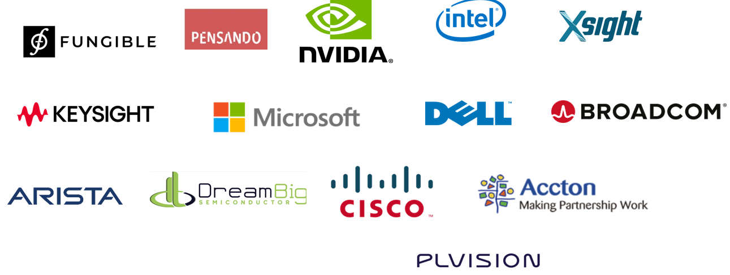
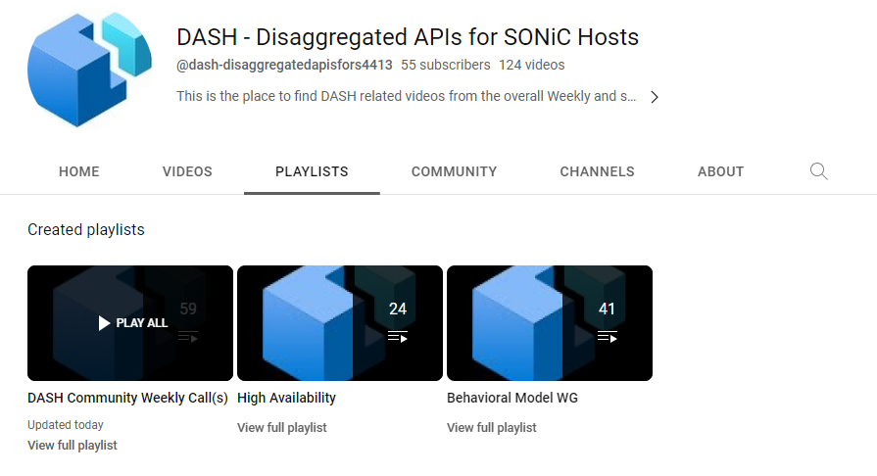
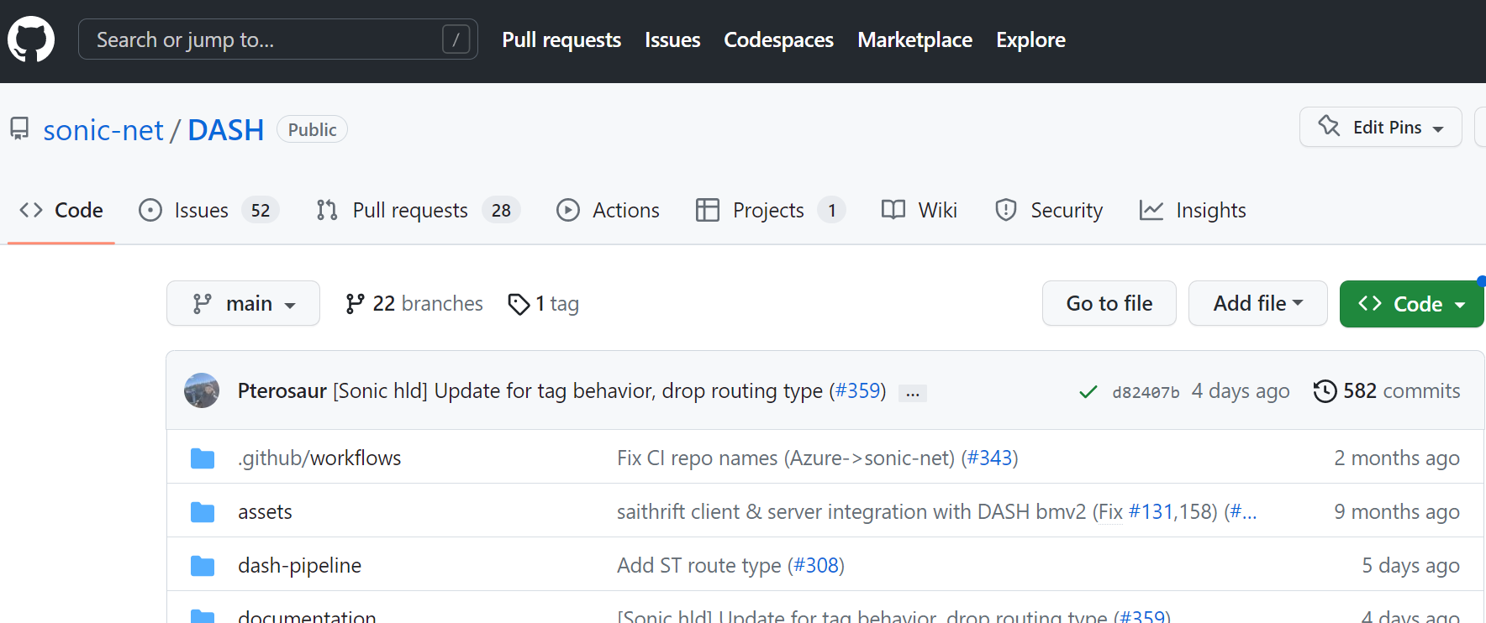
DASH Community – Strong and Growing weekly! (9am Pacific Wednesdays)
SONiC-DASH - Google Groups
SONiC-DASH-Test-Workgroup - Google Groups
https://github.com/sonic-net/DASH
https://www.youtube.com/channel/UCNE3zNwJqcEyLX9ejKrLtUA/playlists
Notes:
Microsoft led, multiple Community contributors

Slide 11
SONiC-DASH
Architecture
Behavioral Model
We build upon the traditional SONiC Underlay dataplane
New DASH services are modeled in P4 and comprise the formal definition of the pipeline
SAI Headers are auto-generated from P4 code; these headers are used to integrate SAI into SONiC middleware (syncd daemon)
Test-cases are written against the SAI interface
Tests are run using a behavioral model and popular test harnesses (SAI-PTF, SAI Challenger)
Same tests can be executed at Line Rate on hardware

Slide 12
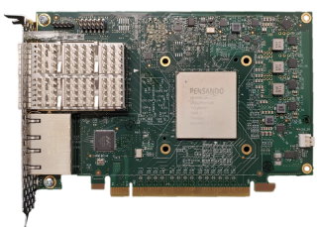













SONiC DASH – Trad. SONiC Underlay + DASH Overlay services (SDN)
SONiC is a Debian Linux-based network operating system supported by more than 100 switch platforms and all major ASICs
Relies heavily on a Switch Abstraction Layer (SAI)
SDN North Bound Interface (gNMI)
NB APIs
More apps
SNMP
BGP
Utility
DASH
Container
Platform
BGP
IPv6
SONiC
Shim
DASH APIs or SONiC on NIC?
Redis DB with DASH Objects
South Bound Interface
SB APIs
DASH Extended SAI
Hardware
Switch Abstraction Interface – (SAI) DASH Extensions
Notes:
We are extending SONiC to include DASH extensions
-Added a container into SONiC (gNMI-DASH container) it has a NB interface and it’s where the SDN controllers will program both the switch and the DPUs,
-Extended the SONiC ReDis db that holds the Switch State to hold DPU state now.
-Extended SAI to include DPU extensions.
This is all of the connection level abstractions we needed.
-SONiC is L3 technology, DASH is connection oriented technology.
This included work with the PNA, OpenCompute/SAI, and PTF communities.

Slide 13


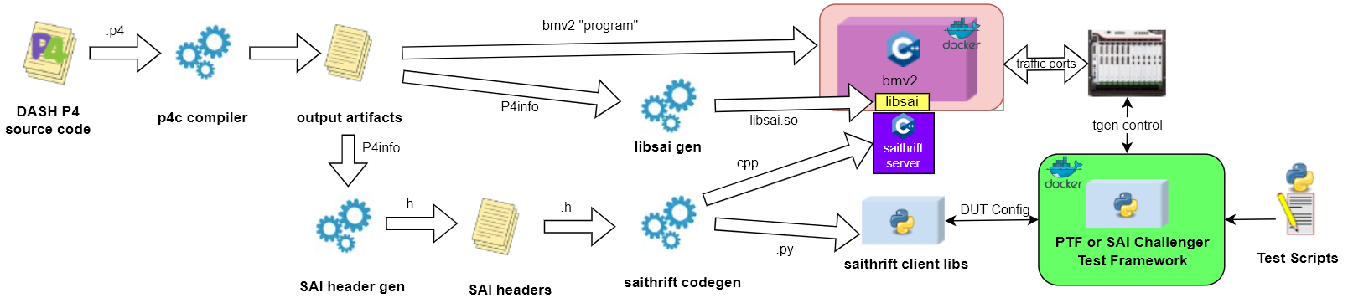
P4 as a source of truth – DASH Overlay pipeline
Work in Progress
Notes:
Code generates from one point
5 minutes time from first opening

Slide 14
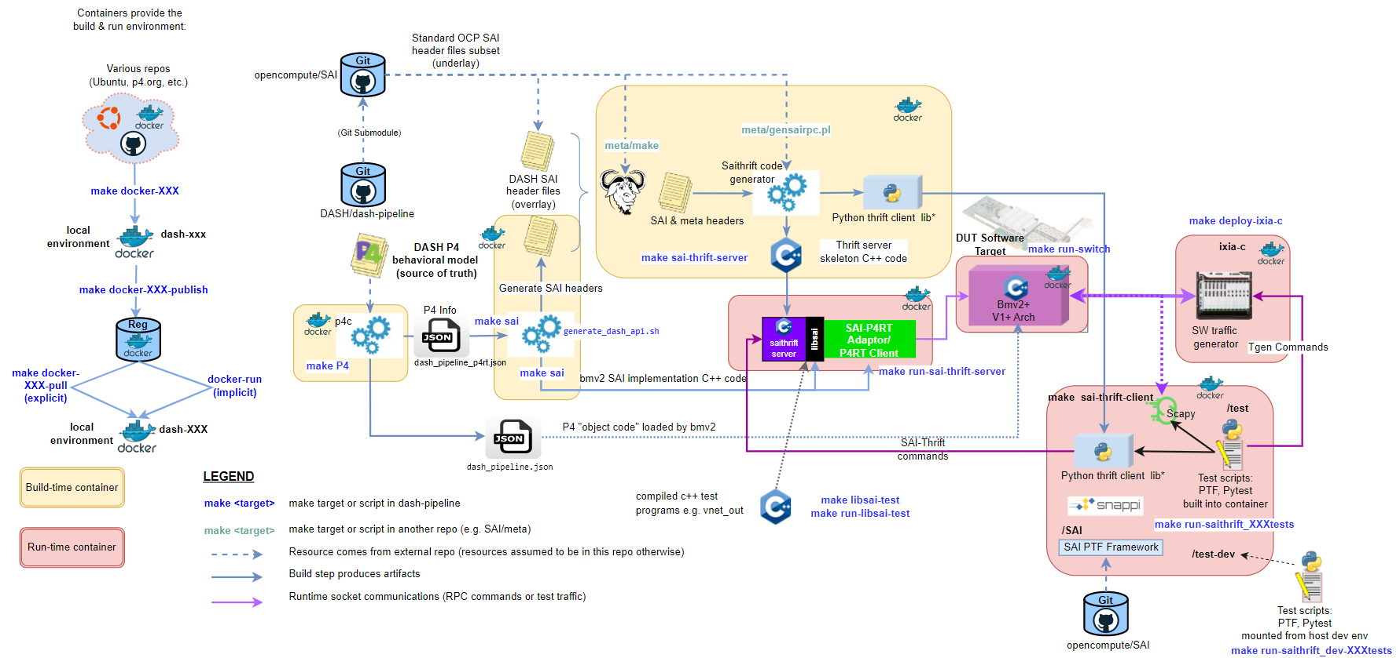

Full CI/CD Workflow – 5 minutes TFD*
make all
make run-switch
make run-saithrift-server
make run-all-tests
*Time to first dopamine
https://github.com/sonic-net/DASH/blob/main/dash-pipeline/README-dash-workflows.md#build-workflow-diagram

Slide 15
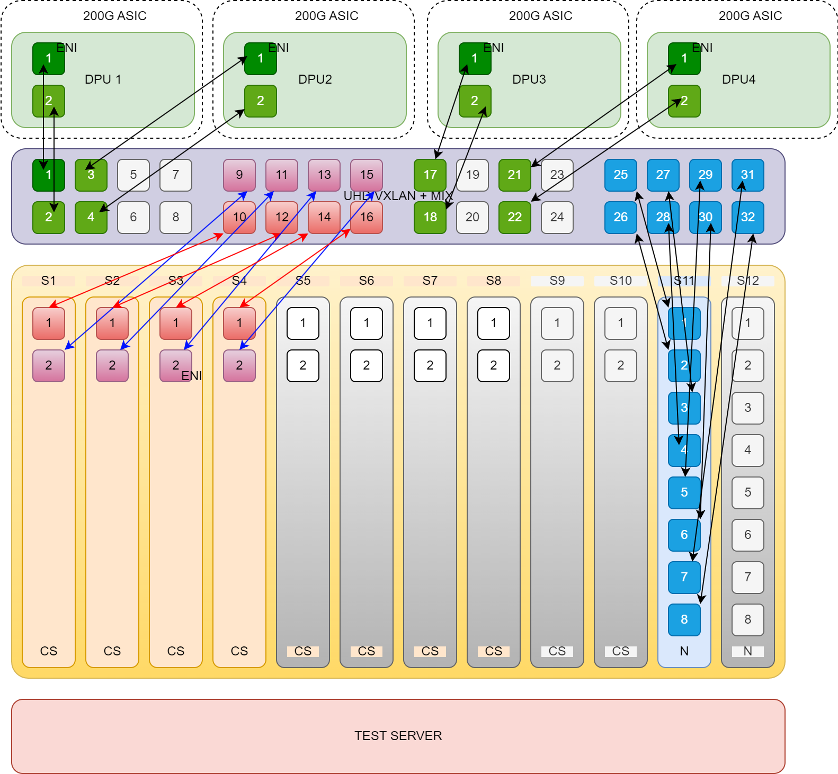
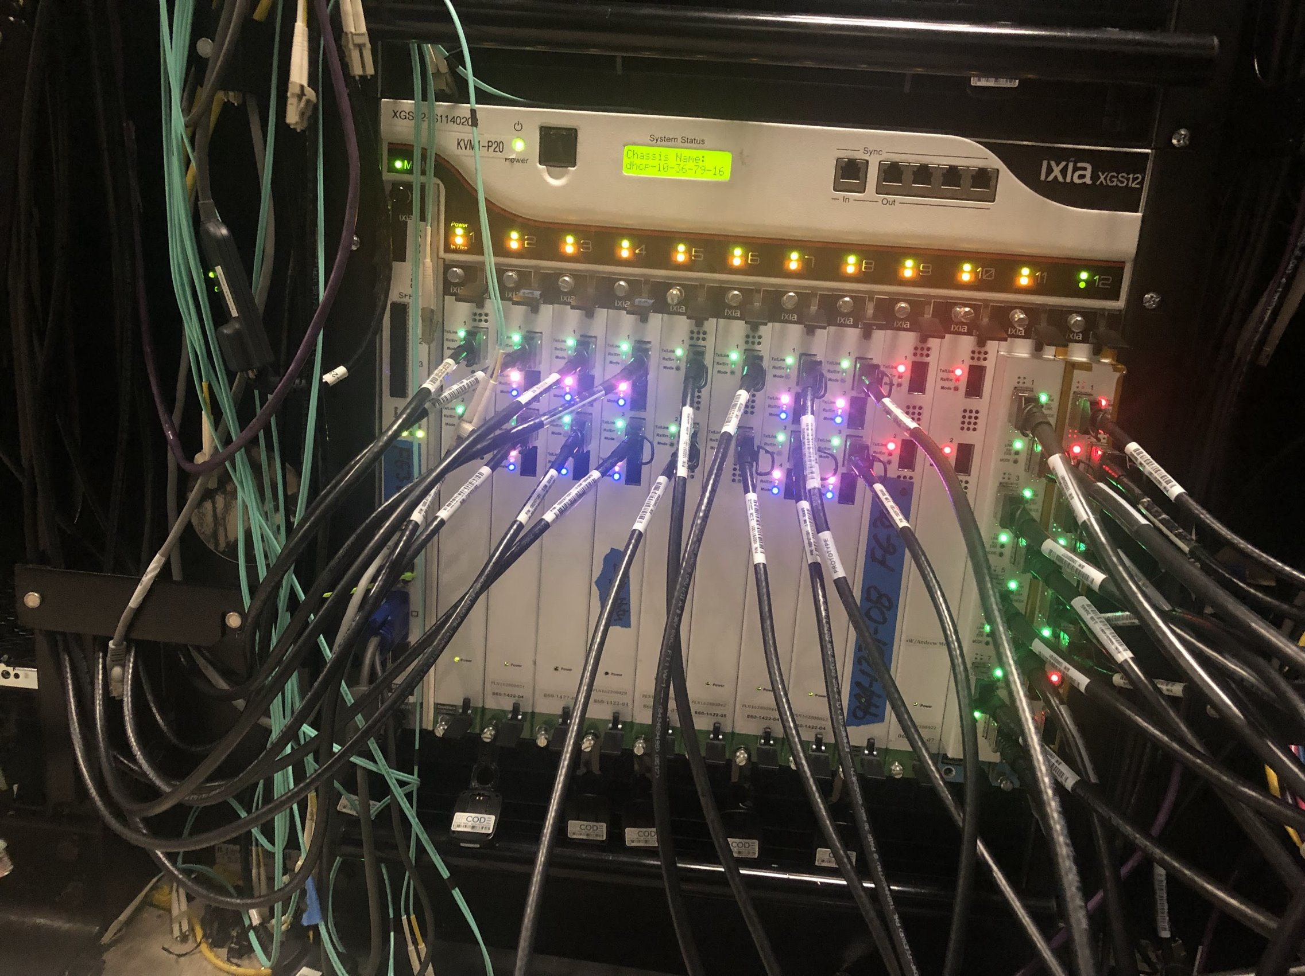
The DASH testing Challenge
Pre-Silicon testing
Program Scale Testing Requirements for LAB Validation (Hero test)
Post deployment validation

Slide 16
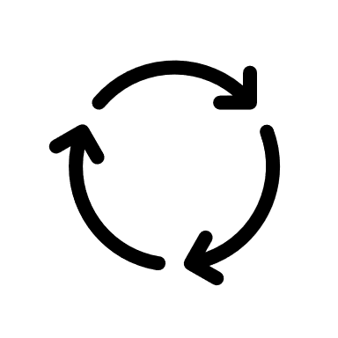

DASH requires High-scale, High-performance, connection-oriented (stateful) testing
Connections per Second
95% require < 10s of k/sec
<5% require 100s of k/sec
<1% require 1M+/sec
Active Connections
10% of connections active
30% of connections active
100% of connections active
Total Connections/Flows
100k connections
1M connections
10M connections
Notes:
Solving for the cases in red circles
Not going to hit the cache very often if the connections are active.
TikTok need Millions of connections on each VM

Slide 17
DASH Cloud Connection Management Scale
(Scaling per 200G)
32GB – 64GB
64M+ connections
10M+
Mappings
1k Rules x 10 levels
High Speed Fabric & Memory Controller
200G
VNI
ENI
Connection
Tracking
Forwarding/Mappings
Rules Processing
200G
200G
Rules
Processing
Forwarding
/Mappings
Connection
Tracking
200G
ENI
VNI
Notes:
Scale #’s keep going up, now down.
Holds up to 64M connections for 200G, we can get 256M connections when we go up to 800G (64x4) scales linearly
10,000 rules per ENI
64 ENIs
Does this fit into the memory? Yes…
Define what tables look like

Slide 18
Where to find much more detail
  DASH Github: http://github.com/sonic-net/DASH
  SONiC Github : http://sonicfoundation.dev/
  Mailing list: sonic-dash@googlegroups.com
  sonicproject@googlegroups.com
Inviting contributions in all areas
    Azure’s documentation for all cloud services deployed and enabled by DASH
    DASH/SONiC/SAI/P4/Behavior Models
    Hardware platform
    New features, applications and tools
    Download, test, deploy!
Notes:
Goal is to have 1 DPU Operating System for the cloud

